Slide 1

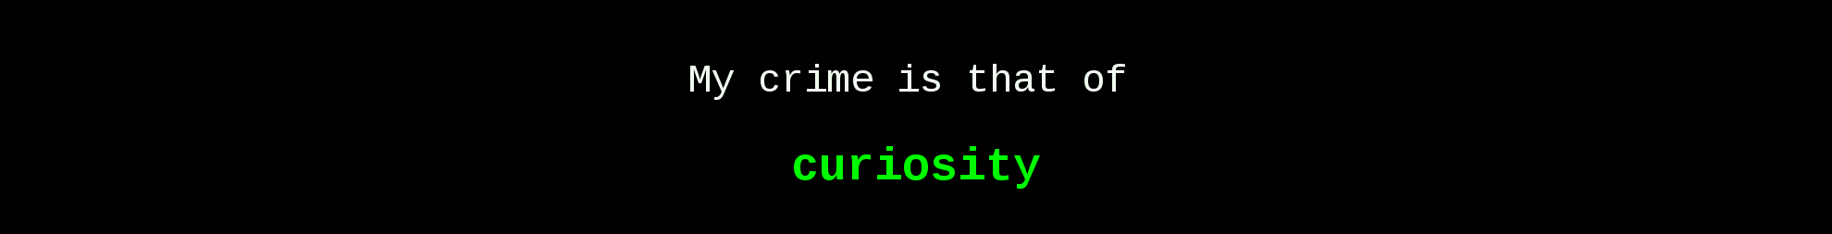
Practical
Reviews – 1a

Slide 2
Practical 1a
Network Protocols
LEARNING OUTCOMES – Topic 1a-b
At the end of these practicals, you will be able to :
Analyse network traffic using wireshark.
Explain the purpose of common network protocols.
Identify the ports used by common network protocols.
Apply various offensive security techniques on network services.

Slide 3
Review Practical 1a
Preparing the VMWare Workstation software
Before You Begin
You can choose to use either DHCP or configure a static IP address.
IMPORTANT NOTE :
Only for VMWare Workstation virtualization software
Whether using DHCP or static IP address on your guest machines.
See Next Slide

Slide 4
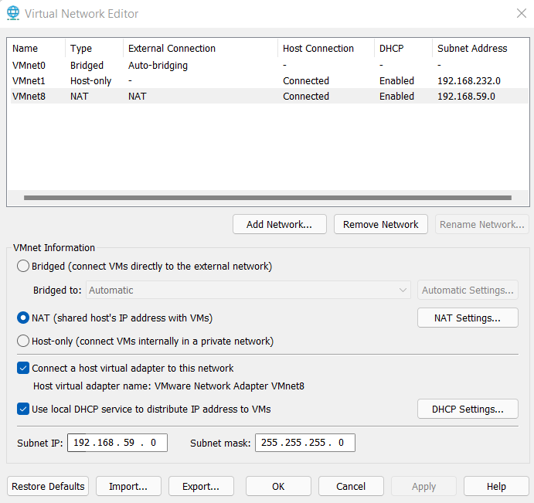
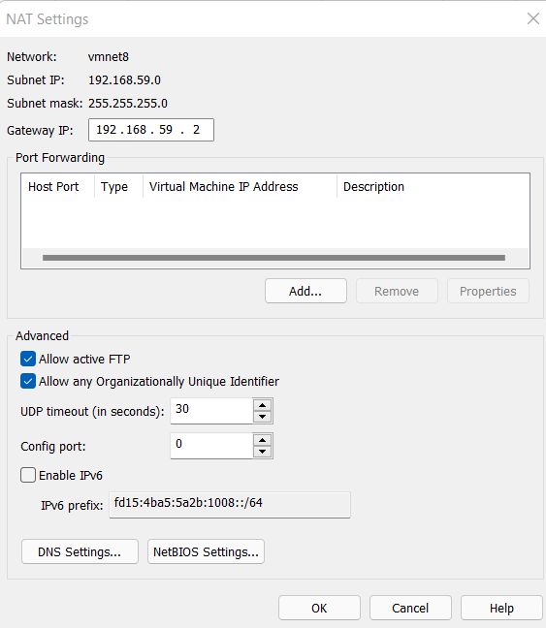
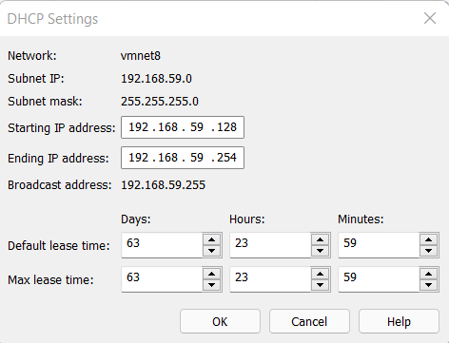
Review Practical 1a
Preparing the VMWare Workstation software
Before You Begin
Important Note for VMWare Workstation virtualization software’s DHCP usage
Make sure these selections and values are set.

Slide 5
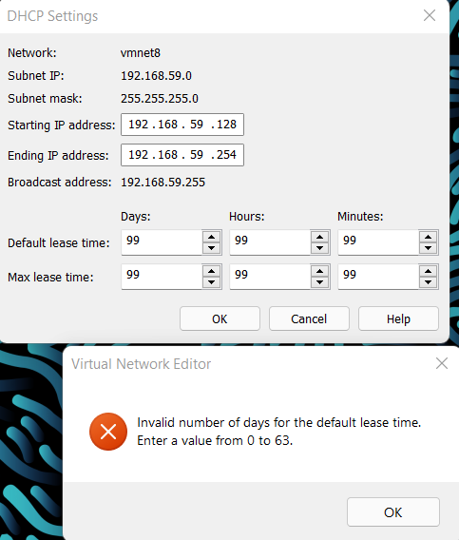
Review Practical 1a
Preparing the VMWare Workstation software
Before You Begin
Important Note for VMWare Workstation virtualization software’s DHCP usage
Real-World tips:
How to find out undocumented information?
Solicit for information by entering erroneous 999 in all fields and click OK to find out the maximum allowed value in each field.

Slide 6
Review Practical 1a
EXERCISE 3 & 4
Exercise 3
Configuring network settings in Kali Linux
See Next Slide
Exercise 4
Setting up web-server2 virtual machine
See Next Slide

Slide 7
Review Practical 1a
EXERCISE 3 & 4
IMPORTANT NOTE :
Use Either DHCP or STATIC IP addressing.
If static, use ONE way below, then proceed to Ex 5.
3 ways for static IP address:
By GUI (Steps 28 – 34. Step 35 optional)
Permanent. Reboot/network reactivation does not revert IP address.
By Configuration File (Steps 36 – 39. Steps 40 & 41 optional)
Permanent. Reboot/network reactivation does not revert IP address.
By Command Line (Steps 42 – 43. Steps 44 & 45 optional)
NOT permanent. Reboot/network reactivation revert IP address.
Strongly Advised to try out each way above to understand.

Slide 8
Review Practical 1a
EXERCISE 3 & 4
Real-World tips:
How to configure permanent static IP address based on the
Operating System used for Webserver?
REMEMBER: Can ask Mr G.
https://www.cyberciti.biz/faq/howto-setting-rhel7-centos-7-static-ip-configuration/

Slide 9
Review Practical 1a
EXERCISE 5
Exercise 5
Using Wireshark
Demonstrate that Wireshark can filter a captured traffic file by specific traffic types.
Demonstrate that Wireshark can export HTML file and its objects using Export function on a captured traffic file.
Demonstrate that Wireshark can reconstruct a network conversation using TCP Stream from a captured traffic file.
Demonstrate that Wireshark can use name resolution function on IP and MAC addresses on a captured traffic file.

Slide 10
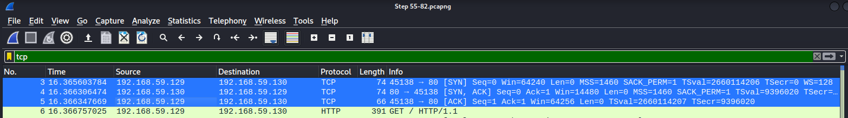
Review Practical 1a
EXERCISE 5
Q: Which filter keyword can also locate 3-way handshake?
Tips: Which transport layer protocol uses 3-way handshake?
Q: Why IP addresses swap between Source & Destination columns?
REMEMBER:
3-way handshake [SYN] → [SYN ACK] → [ACK]
Q: If HTTPS, can objects be exported? If no, why? If yes, how?
REMEMBER, can ask Mr G.

Slide 11
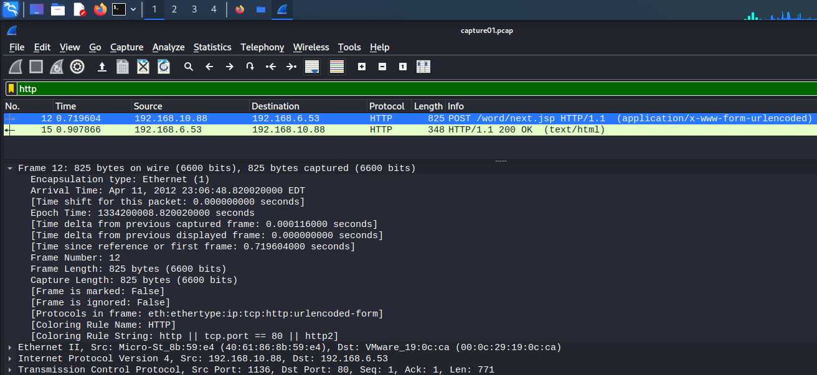
Review Practical 1a
EXERCISE 5
i: Which column shows packet number (also called Frame Number)?
i: All packets captured in Wireshark has timestamps. Located in 1st line “Frame” summary.

Slide 12
Review Practical 1a
EXERCISE 5
Q: If Wireshark export function did not list a file from HTTP packet capture (but you think it should be listed), always take following actions to ensure:
STOP capturing → CLEAR browser’s cache → START capturing → RELOAD webpage in browser → STOP capturing → Export HTTP
WHY?
All packets captured in Wireshark has timestamps. Located in 1st line “Frame” summary.

Slide 13
Review Practical 1a
EXERCISE 7
Exercise 7
Connecting to FTP Server
Identify 3-way handshakes in FTP traffic.
Demonstrate that FTP traffic unencrypted and insecure.

Slide 14
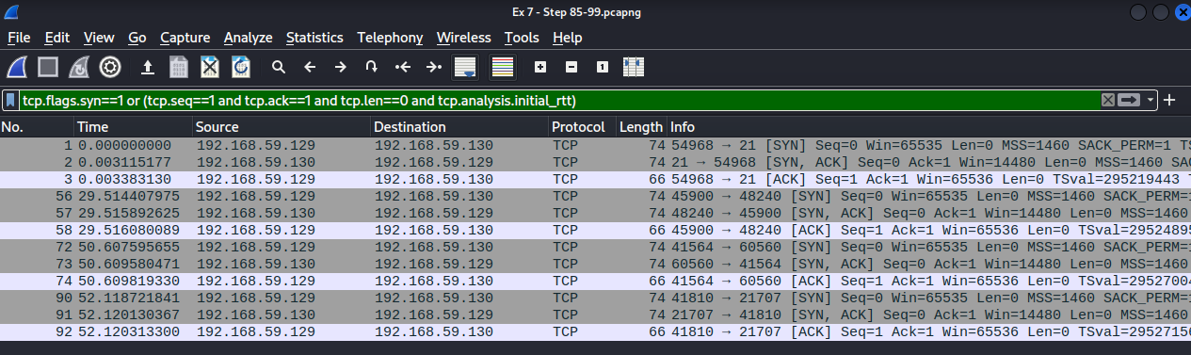
Review Practical 1a
EXERCISE 7
Q: Why are there multiple 3-way handshakes in FTP?
Try TCP 3-way handshake filter, and then Start/Stop Wireshark capture for each of these actions to find out.
→ initiate FTP to webserver
→ login to FTP session
→ List FTP directories and files
→ Download files from FTP
→ Exit FTP session

Slide 15
Review Practical 1a
EXERCISE 8
Exercise 8
Using Telnet
Demonstrate that Telnet traffic is unencrypted and insecure.

Slide 16
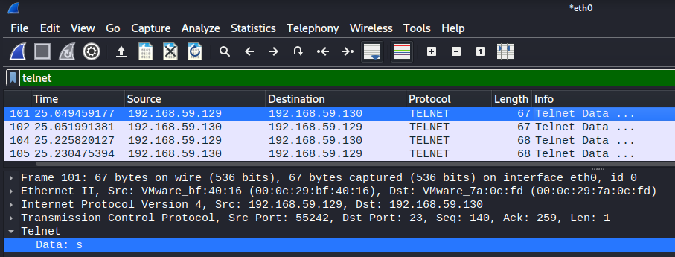
Review Practical 1a
EXERCISE 8
Q: Can Telnet be used for file transfer by itself?
REMEMBER: Can ask Mr G.
O: Does Telnet create a packet for every “character” for an input sent?
Try Telnet filter in Wireshark capture to find out.
Example of inputs:
student00
ls
exit

Slide 17
Review Practical 1a
EXERCISE 9
Exercise 9
Using SSH, SFTP and SCP at command line
Demonstrate that information is encrypted using a SSH connection instead of Telnet.
Demonstrate that information is encrypted using SFTP instead of FTP.
Demonstrate that information is encrypted using SCP.
Demonstrate the functional difference between SFTP and SCP.

Slide 18
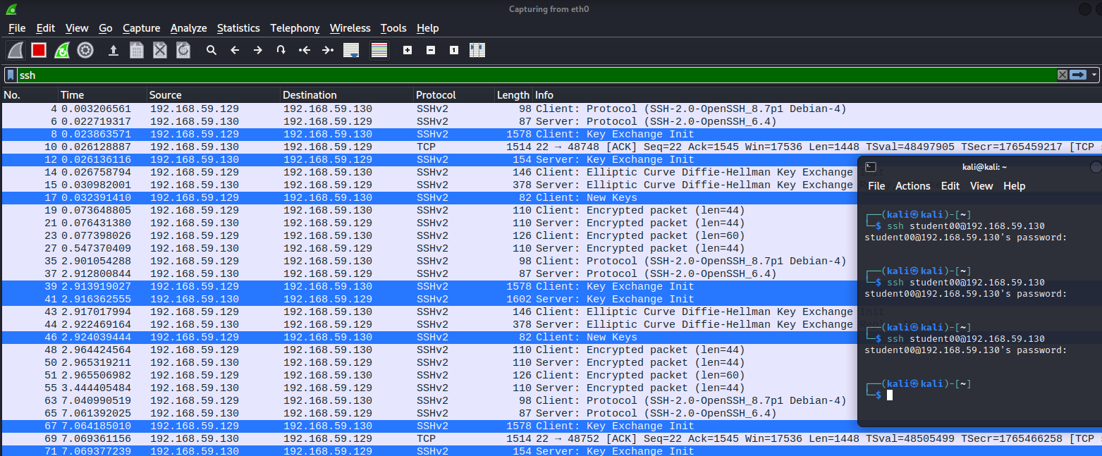
Review Practical 1a
EXERCISE 9
O: Notice how many packets are generated for each key exchange?
Q: Does key exchange take place everytime a SSH connection is made?
Try SSH filter in Wireshark capture, then connect and disconnect SSH sessions multiple times.

Slide 19
Review Practical 1a
EXERCISE 13 & 14
Exercise 13
Ping and Default Firewall Settings
Demonstrate that Windows Firewall can block and unblock packets based on desired traffic types.
Exercise 14
Using PuTTY on Windows to Connect to SSH Server
Demonstrate that PuTTY is the graphical equivalent of SSH for Windows

Slide 20


